Slide 1

Complementary-Similarity Learning using Quadruplet Network
Mansi Ranjit Mane

Slide 2


E-commerce Recommender Systems
Nancy
eCommerce Customer
Millions of items in eCommerce Catalog/ Warehouse
Notes:
Currently eCommerce giants like Walmart, Amazon host millions of products. But are so many buried products inside an eCommerce warehouse that are not reached by customers. For presenting the items to customers

Slide 3
Item Relationships
Similarity/ Substitutes
Show similar items during
Helps user explore
Notes:
To enable users discover relevant items ,we need to understand relationship between items first. when a
customer wishes to purchase a TV, (s)he often would be interested
in first exploring options for TVs, before deciding upon which TV
to purchase. It’s useful to show similar TVs during this phase.
Once (s)he has purchased the TV, additional product
suggestions for tv stand or hdmi cable can be helpful

Slide 4
Item Relationships
Complementary
Show after purchase add example e.g. if someone has purchased dress, additional suggestions like sandals, purse etc

Slide 5

Challenges
Lack of ground truth for complementary items
Cold-start items
Differentiation between similar and complementary items
Notes:
Co-purchase data is usually available for only a small percentage of items in an item catalog, e.g., Pareto principle Therefore, modeling approaches primarily relying upon customer interaction data (co-views, co-purchases), such as collaborative filtering, would not properly handle cold-start or low-engagement items.
2. While learning functional complementary relations, one also needs to learn similarity, to be able to differentiate between complementary items and similar items. If a model is not able to differentiate between the two relations, spurious complementary recommendations can be surfaced. For example, given shoes as an anchor item, one can easily end up recommending different types of other shoes as complementary items, which is not ideal from a customer experience perspective.
3. if a customer is shopping for a top, reminding customers about a set of jeans, belt, and scarf is more useful to the user than just recommending a set of complementary jeans

Slide 6
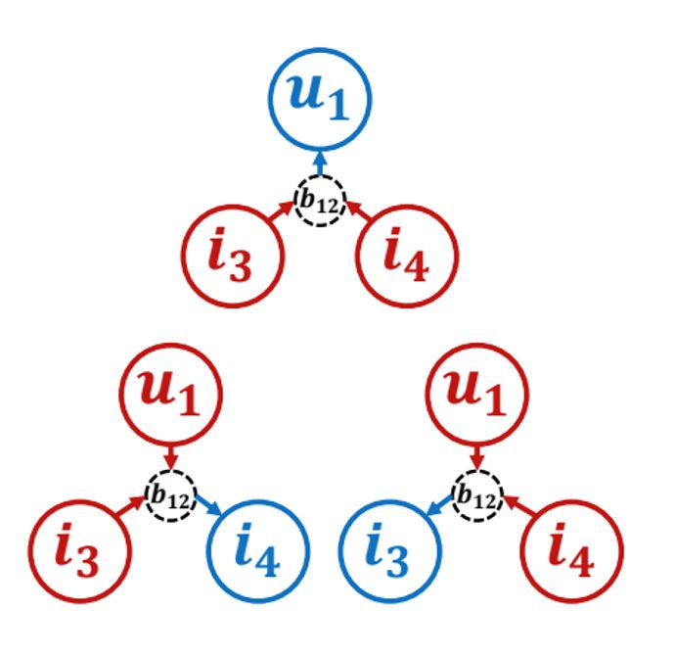
Prior Work
Triple2vec (Wan, CIKM 18)
Dual item embeddings
Maximize dot product between item pairs and user vectors
Challenges:
Solves co-purchasing more than "complementary"
Transitivity leads to similar items in recommendations
Does not handle cold-start items
Notes:
NEED TO COMPARE AGAINST KDD15 AND ECCV18 papers, also the LVAE paper
Find papers that do both "similar" and "complementary"
Dual Embedding Approach
Mostly for basket completion, not complementary

Slide 7
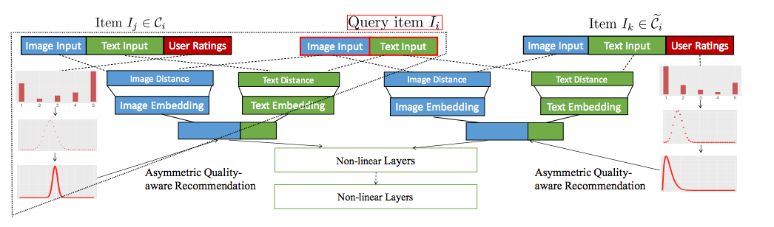
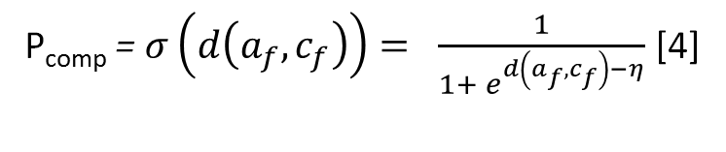
Prior Work
Neural Complementary Recommender (ENCORE) - (Zhang, RecSys 18)
Challenges:
Transitivity
P_{comp} = $σ\left(d\left(a_{f},c_{f}\right)\right)= \frac{1}{1+ e^{d\left(a_{f},c_{f}\right)−η}}$ [4]
Notes:
Recsys 18 – Zhang, Caverlee
1. $d\left(a_{f},c_{f} \right)$ = 0, P = 1/(1+e(-n))
2. $d\left(a_{f},c_{f} \right)$ = inf, P = 1/(1+e(inf) = 0
3. $d\left(a_{f},c_{f} \right)$ = - inf, P = 1/(1+e(-inf) = 1

Slide 8
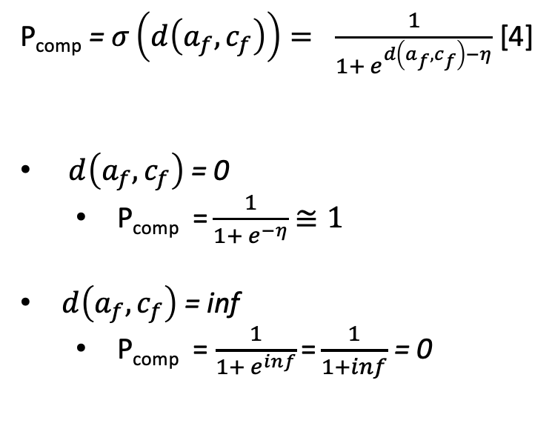
Prior Work
Neural Complementary Recommender (ENCORE) - (Zhang, RecSys 18)
Challenges:
Transitivity
P_{comp} = $σ\left(d\left(a_{f},c_{f}\right)\right)= \frac{1}{1+ e^{d\left(a_{f},c_{f}\right)−η}}$ [4]
$d\left(a_{f},c_{f}\right)$ = 0
P_{comp} = $\frac{1}{1+ e^{−η}}$ $≅1$
$d\left(a_{f},c_{f}\right)$ = inf
P_{comp} = $\frac{1}{1+ e^{inf}}$ = $\frac{1}{1+inf}$ = 0
Notes:
Recsys 18 – Zhang, Caverlee
1. $d\left(a_{f},c_{f} \right)$ = 0, P = 1/(1+e(-n))
2. $d\left(a_{f},c_{f} \right)$ = inf, P = 1/(1+e(inf) = 0
3. $d\left(a_{f},c_{f} \right)$ = - inf, P = 1/(1+e(-inf) = 1

Slide 9
Amazon Dataset
Amazon Clothing, Shoes, and Jewelry data[2]
Category information and title
Complementary pairs: bought together by users from different categories
Similar pairs: items that lie in same category
Negative items: Randomly sample items which do not meet above criteria
Quads: anchor, complementary, similar, negative items
Train quads: 3.3M, Test quads:0.3M
https://github.com/mansimane/quadnet-comp-sim
Notes:
TODO: add restriction for similarity to be "same category AND co-viewed"
Complementary – co-purchased, different categories
Similar – sampled from same category as anchor
Negative – sampled at random
Example anchor item:
A: [[\"Clothing, Shoes & Jewelry\",\"Boys\",\"Clothing\",\"Jeans\"]]
C: [[\"Clothing, Shoes & Jewelry\",\"Boys\",\"Clothing\",\"Tops & Tees\",\"Tees\"]] - U.S. Polo Association Boys 8-20 V-Neck Pony Tee (White/Blue, 18

Slide 10
Amazon Dataset Attribute Availability
Attribute | Coverage
Image | 99.99
Description | 5.68
Title | 99.95
Price | 38.29
Brand | 6.25
Notes:
Why we decided to use title
Futuerwork: metadata, image embeddings

Slide 11
Example Quadruplet
Anchor
Complementary
Similar
Negative
Lee Dungarees Men’s Big, Tall Carpenter Jean
Key Apparel Men's Big-Tall Short Sleeve Heavyweight Pocket Tee Shirt
Wrangler Men's Rugged Wear Relaxed Straight Fit Jean
Black and White Herringbone Wool Suiting Extra Long Tie
Notes:
B001249LAS"[[\"Clothing, Shoes & Jewelry\",\"Men\",\"Clothing\",\"Jeans\"],[\"Clothing, Shoes & Jewelry\",\"Men\",\"Big & Tall\",\"Jeans\"]]"Lee Dungarees Mens Big &amp; Tall Carpenter Jeanhttp://ecx.images-amazon.com/images/I/41KND0jAzbL._SX342_.jpg
B0057X9JUW"[[\"Clothing, Shoes & Jewelry\",\"Men\",\"Clothing\",\"Shirts\",\"T-Shirts\"],[\"Clothing, Shoes & Jewelry\",\"Men\",\"Big & Tall\",\"Shirts\",\"T-Shirts\"]]"Key Apparel Men's Big-Tall Short Sleeve Heavyweight Pocket Tee Shirt http://ecx.images-amazon.com/images/I/41YxcASfIvL._SX342_.jpg
B006K9Y7DG"[[\"Clothing, Shoes & Jewelry\",\"Men\",\"Clothing\",\"Jeans\"],[\"Clothing, Shoes & Jewelry\",\"Men\",\"Big & Tall\",\"Jeans\"]]"Wrangler Men's Rugged Wear Relaxed Straight Fit Jean http://ecx.images-amazon.com/images/I/41X9ZyhyILL._SX342_.jpg
B00ADSIYGQ"[[\"Clothing, Shoes & Jewelry\",\"Men\",\"Accessories\",\"Neckties\"]]"Black and White Herringbone Wool Suiting Extra Long Tiehttp://ecx.images-amazon.com/images/I/51OobS1DS2L.jpg

Slide 12
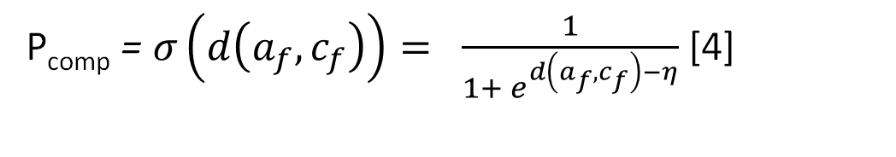
Motivation
Why not just optimize for complementary items?
P_{comp} = $σ\left(d\left(a_{f},c_{f}\right)\right)= \frac{1}{1+ e^{d\left(a_{f},c_{f}\right)−η}}$ [4]
a
Wonder Nation Twist-Front Graphic T-Shirt
b
Wonder Nation Graphic Hi-Lo T-Shirt
c
Women's Knit Skinny Cargo Pant
Notes:
Let’s say we are trying to just predict if item c is complementary to items a or not. One can train the model to maximize the likelihood for predicting their complementary relationship. Here d can be any distance function like dot product, cosine or Euclidean distance.
What the loss function for this model will do is trying to do minimize the distance between feature representations between item A and C, so that the power of e is as negative as possible if we take dot product between af and cf

Slide 13
Motivation
Why not just optimize for complementary items?
Challenges:
Transitivity
P_{comp} = $σ\left(d\left(a_{f},c_{f}\right)\right)= \frac{1}{1+ e^{d\left(a_{f},c_{f}\right)−η}}$ [4]
$d\left(a_{f},c_{f}\right)$ = 0
P_{comp} = $\frac{1}{1+ e^{−η}}$ $≅1$
$d\left(a_{f},c_{f}\right)$ = inf
P_{comp} = $\frac{1}{1+ e^{inf}}$ = $\frac{1}{1+inf}$ = 0
Notes:
Recsys 18 – Zhang, Caverlee
1. $d\left(a_{f},c_{f} \right)$ = 0, P = 1/(1+e(-n))
2. $d\left(a_{f},c_{f} \right)$ = inf, P = 1/(1+e(inf) = 0
3. $d\left(a_{f},c_{f} \right)$ = - inf, P = 1/(1+e(-inf) = 1

Slide 14
Motivation
Feature Transformation
Feature Transformation
Feature Transformation
Learnt Representation Space

Slide 15
Goal
Negative items
Learn representation space which can differentiate between similar and complementary items
Complementary items
Similar items

Slide 16
Problem Formulation
a: Anchor item
c: Complementary item to anchor item
s: Similar item to anchor item
n: Negative item to anchor item
a_{f}′ , c_{f}′ , s_{f}′ , n_{f}′ : Normalized learnt feature representation for a, c, s, n

Slide 17
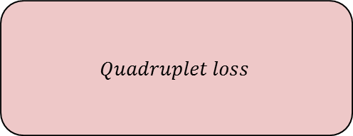
Network Architecture
GUSE
a_{t}
FC
Embedding
a
Shared
non-trainable parameters
Shared
trainable parameters
a_{f}
GUSE
c_{t}
c_{f}
$$Quadruplet loss$$
FC
Embedding
c
GUSE
s_{t}
s_{f}
FC
Embedding
s
n_{f}
GUSE
n_{t}
FC
Embedding
n
Shared
non-trainable parameters
Notes:
Future Work: input embeddings, train E2E
Initial experiments: inconclusive

Slide 18
Feature Representation
Universal Sentence Encoder [1]
Wonder Nation Twist-Front Graphic T-Shirt
512 Dimensional Sentence Embedding
Transformer
Attention Weighted Sum
Notes:
The transformer based sentence encoding model constructs sentence embeddings using the encoding sub-graph of the transformer architecture (Vaswani et al., 2017). This sub-graph uses attention to compute context aware representations of words in a sentence that take into account both the ordering and identity of all the other words. The context aware word representations are converted to a fixed length sentence encoding vector by computing the element-wise sum of the representations at each word position.3 The encoder takes as input a lowercased PTB tokenized string and outputs a 512 dimensional vector as the sentence embedding.
https://arxiv.org/pdf/1803.11175.pdf

Slide 19
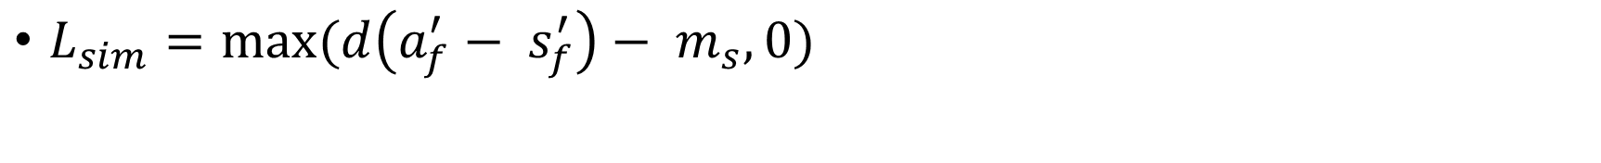
Similarity Loss
$L_{sim}=max(d\left(a_{f}^{′}− s_{f}^{′}\right)− m_{s}, 0)$
s_{f ,} Wonder Nation Twist-Front Graphic T-Shirt
m_{s}
a_{f ,} Wonder Nation Graphic Hi-Lo T-Shirt

Slide 20
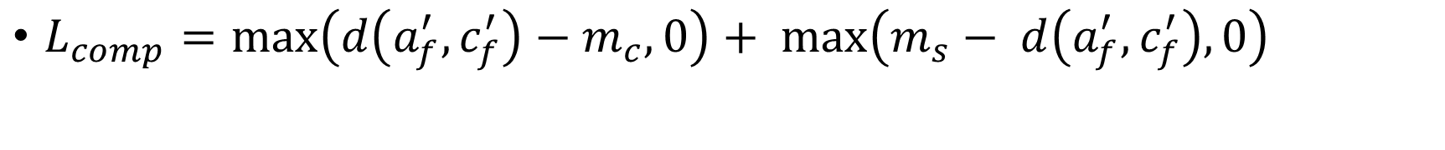
Complementary Loss
$L_{comp}=\max\left(d\left(a_{f}^{′},c_{f}^{′}\right)−m_{c}, 0\right)+ \max\left(m_{s}− d\left(a_{f}^{′},c_{f}^{′}\right), 0\right)$
m_{s}
c_{f,}
Women's Knit Skinny Cargo Pant
m_{c}
a_{f}
Wonder Nation
Graphic Hi-Lo T-Shirt

Slide 21
Negative Loss
$L_{neg}= \max\left(m_{n}− d\left(a_{f}^{′},n_{f}^{′}\right), 0\right)$
m_{s}
n_{f,}
1/2 Sleeve Pageant Wedding Bridesmaid Dress
m_{c}
a_{f}
Wonder Nation
Graphic Hi-Lo T-Shirt

Slide 22
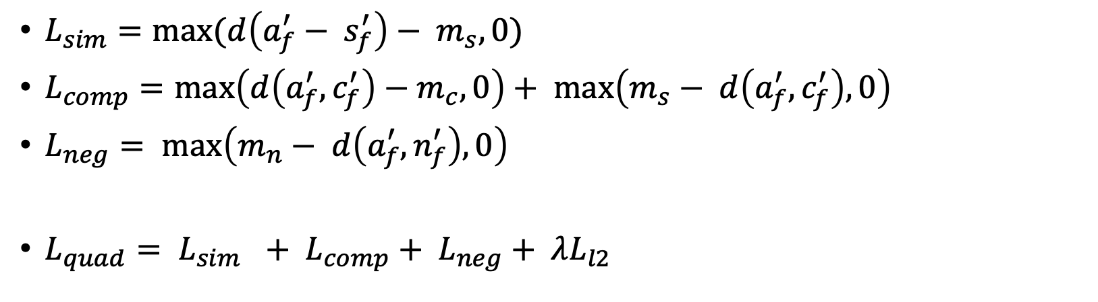
Quadruplet Loss
$L_{sim}=max(d\left(a_{f}^{′}− s_{f}^{′}\right)− m_{s}, 0)$
$L_{comp}=\max\left(d\left(a_{f}^{′},c_{f}^{′}\right)−m_{c}, 0\right)+ \max\left(m_{s}− d\left(a_{f}^{′},c_{f}^{′}\right), 0\right)$
$L_{neg}= \max\left(m_{n}− d\left(a_{f}^{′},n_{f}^{′}\right), 0\right)$
$L_{quad}= L_{sim }+ L_{comp}+ L_{neg}+ λL_{l2}$

Slide 23
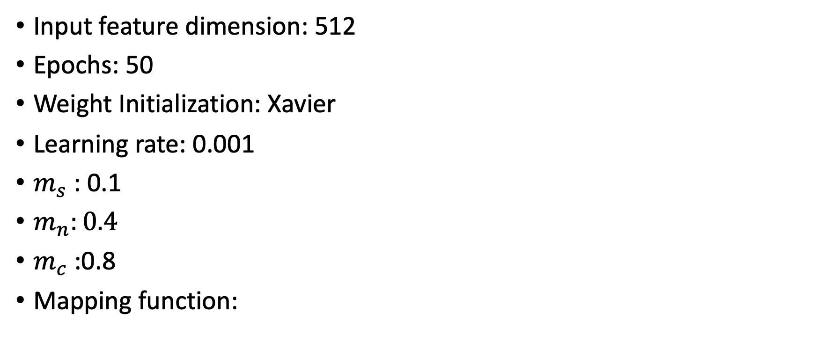
Hyperparameters
Input feature dimension: 512
Epochs: 50
Weight Initialization: Xavier
Learning rate: 0.001
$m_{s}$ : 0.1
$m_{n}:0.4$
$m_{c}$ :0.8
Mapping function:
512
256
GUSE
FC₁ + ReLU
FC₂
Text
128
Notes:
Unit norm vectors
Euclidean distance in range [0, 2]
Batch Size 512

Slide 24
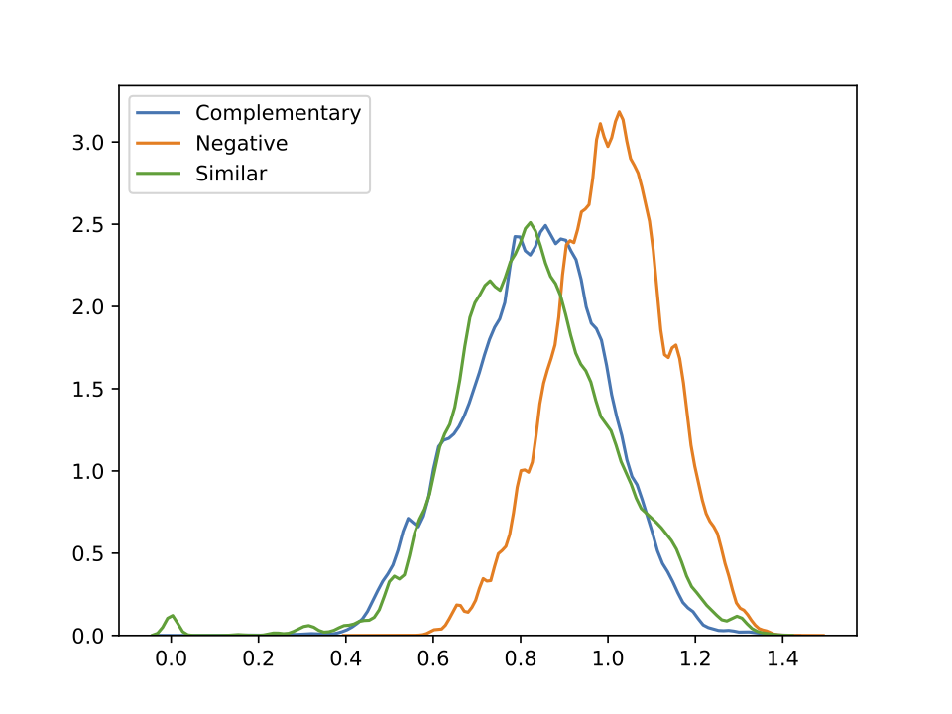
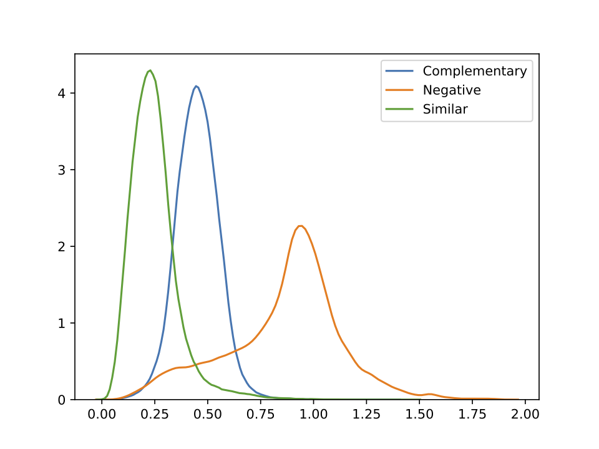
Experiments - Distance Distribution
Before Training
After Training
Notes:
Y Axis – frequency pdf
X Axis – Euclidean distance between two unit norm vectors
Dist^2 = 2-2*cos_dist(v1, v2). => [0, 2]
The X axis is between 0 to 2. (very few values on left hand side of zero are because of float roundings.)
X axis – euclidean distance
||𝐱−𝐲||22 =(𝐱−𝐲)⊤(𝐱−𝐲)
=𝐱⊤𝐱−2𝐱⊤𝐲+𝐲⊤𝐲
=2−2𝐱⊤𝐲
=2−2cos∠(𝐱,𝐲)
=2-2(-1) --- minimum of cos is -1
= 4
Taking square room of both sides,
||𝐱−𝐲||2 = 2 (max value)
Min calculation:
= 2-2(1) --- max of cos is 1
= 0 (min value)
We are taking normalized

Slide 25
Experiments - Distance Distribution
 | Similar |  | Complementary |  | Negative
 | Mean | Std Dev | Mean | Std Dev | Mean | Std Dev
Train Data Before training | 0.82119 | 0.17611 | 0.81975 | 0.15910 | 0.99804 | 0.13286
Test Data Before training | 0.82752 | 0.17853 | 0.83086 | 0.15937 | 1.0037 | 0.12949
Train Data After training | 0.24069 | 0.11226 | 0.45845 | 0.11485 | 0.86774 | 0.27724
Test Data After training | 0.24772 | 0.11485 | 0.45181 | 0.09963 | 0.86023 | 0.27182

Slide 26
ExperimentsAccuracy
Method | Ranking Acc | Complementary Acc | Similarity Acc
Universal Sentence Encoder | 37.68 | - | -
Veit et al. [2] | 14.92 | 91.05 | 56.45
Quadruplet Network | 67.15 | 86.92 | 68
Ranking accuracy is calculated as: d_{s} < d_{c} < d_{n}
Complementary Accuracy: margin_{s} < d_{c} < margin_{c}
Similarity Accuracy: d_{s} < margin_{s}
Notes:
Ranking accuracy is calculated as: ds < dc < dn
Future work:
Compare vs triplet similarity network

Slide 27
Future Work
Modelling asymmetry between relationships
Clustering analysis on learnt embedding space
Notes:
Work in Progress – experiments, evaluation
Label generation scheme left a lot to be desired – human eval still found a lot of similarity labels in complementary or noise.
Clustering – further analysis on similarity, complementary embeddings
Assymetry -> Shoes + Socks. Socks ( no shoes )

Slide 28
References
Cer, Daniel, et al. "Universal sentence encoder" arXiv preprint arXiv:1803.11175 (2018).
Chen, Weihua, et al. "Beyond triplet loss: a deep quadruplet network for person re-identification" ICCV 2017.
Veit, Andreas, et al. "Learning visual clothing style with heterogeneous dyadic co-occurrences" ICCV 2015.
Vasileva, Mariya I., et al. "Learning type-aware embeddings for fashion compatibility" ECCV 2018.
Zhang, Yin, et al. "Quality-aware neural complementary item recommendation" RecSys 2018.
McAuley, Julian, Rahul Pandey, and Jure Leskovec. "Inferring networks of substitutable and complementary products" KDD 2015.
Mengting Wan, Di Wang, Jie Liu, Paul Bennett, and Julian McAuley. "Representing and recommending shopping baskets with complementarity, compatibility and loyalty" CIKM 2018.

Slide 29
Thank You

Slide 30
Inference (offline or RT)
Use Approximate Nearest Neighbor (ANN) indices (FAISS, annoy, nmslib) to perform top-k embedding retrieval
Divide all items into C disjoint groups (via taxonomy or clustering on embeddings)
Create a set of ANN indices:
1 global item index
1 cluster centroid index
C separate cluster indices (of item embeddings associated with that cluster)
Notes:
FAISS, annoy, nmslib
To return top k complementary, we

Slide 31
Inference (offline or RT)
Given query item, obtain query embedding from quadruplet network
Given a query embedding:
Top K similar items:
Nearest neighbor (NN) query on the item index
Top K complementary items:
Goal: Find K closest items whose distance is in range [ margin_{c} , margin_{s} )
1 ) NN query on the cluster index, consider the centroids in range
2) For each in-range cluster, find the top K closest items. Merge the sets and retain the top K in range [ margin_{c} , margin_{s} )
Notes:
FAISS, annoy, nmslib
Note that step 2: can be sped up using individual indices per cluster or taxonomy PT

